Slide 1


Twitter Analysis
Corey McCrea

Slide 2
Business Implications
Twitter data is reflective of public opinion regarding companies
Traveling via plane is often associated with several issues
Why is this?
What can Airlines do to keep customers happy?

Slide 3
Data Breakdown
Twitter data collected over roughly a week in February of 2015
Over 14,000 Entries
Large amount of data means there are a variety of insights to be had
Contains information about tweet sentiment, airline name, location and more

Slide 4
Insight Report
Sentiment Distribution
Negative Tweet Reasoning
Tweet Count Over Time
Key Summary
Overall & Per Airline

Slide 5
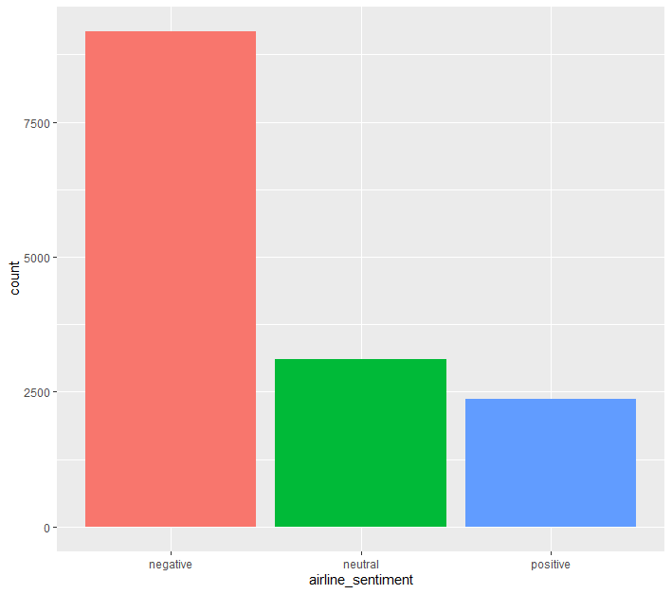
Overall Distribution of Tweets
Large amount of negative tweets
Negative tweets are more than neutral and positive combined
How does this break down per airline?

Slide 6
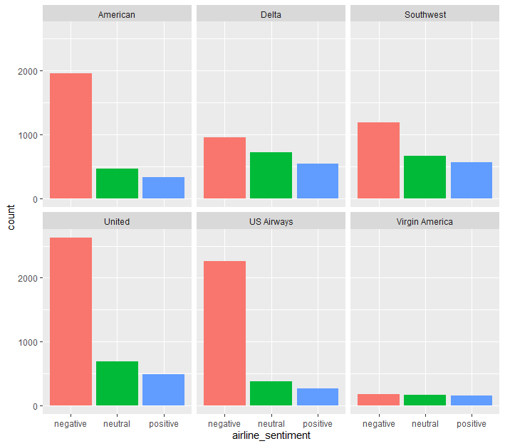
Airline Tweet Distribution
American, United, and US Airways all have a much higher amount of negative tweets
Virgin has a low number overall
What is the driver for these negative tweets?

Slide 7
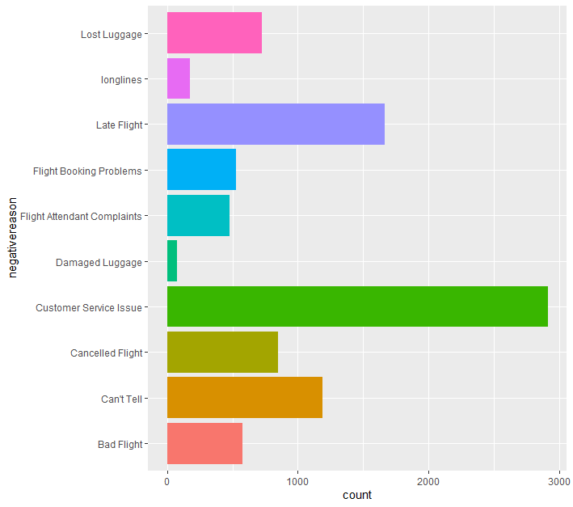
Reasoning of Negative Tweets
Customer Service seems to be the largest issue causing this negative sentiment
Late Flight is also a large number, but this is mostly out of the airlines control
Is there a particular day that causes issues?

Slide 8
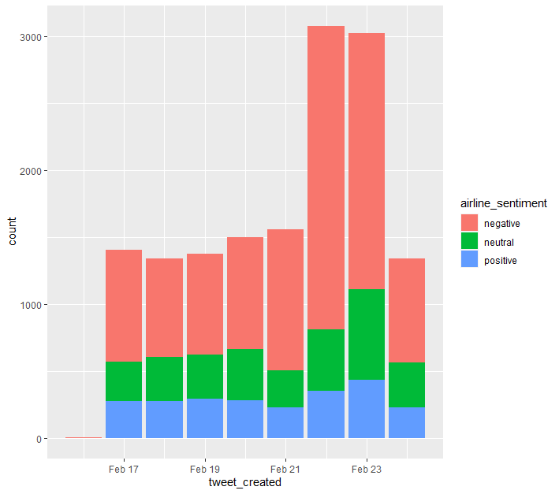
Tweet Count over Time
Unusually high number of tweets on February 22nd and 23rd
These high numbers correlate to a storm that grounded over 1,100 flights involving Dallas, TX
The large number of tweets regarding American could be driven by their Hub in Dallas

Slide 9
Key Executive Summary
Overall, most tweets about airlines are negative
Certain airlines were disproportionately tweeted about
Driven by cancelations due to a storm
Most sentiment was driven by customer service issues
Data would be more robust if it was collected over a longer period

Slide 10
Appendix
Dataset Assessment
Action List

Slide 11
Dataset Assessment
Overall, this was a very messy dataset
Large number of columns were missing entries
Tweet location column just has user set location which isn’t very insightful for this application
Like all social media data, it is a large amount of text which can be difficult to parse into meaningful analysis
Very limited with only about a week of collection

Slide 12
Action List
Data Exploration
Loading data into R
Exploring summary stats
Deciding which columns were useful
Data Cleaning
Counting NAs of each column to filter what is usable
Dropped tweet_cord, *_gold columns, confidence columns
Analysis
Plotting various columns, looking for trends
Attempted to use tweet contents to create models

